Slide 1

BANNARI AMMAN INSTITUTE OF TECHNOLOGY
S8 PROJECT WORK ll -VIVA VOCE(04.04.2023)
DESIGN FOR VISITOR AUTHENTICATION BASED ON FACE RECOGNITION TECHNOLOGY USING CCTV
EXTERNAL OWN PROJECT
Team details
Name :VIKRAM M,VIJAY J,MOHAMED MOHAIDEEN A
RegNo:191EC311,191EC310,191EC205
Dept : ELECTRONICS AND COMMUNICATION ENGINEERING
Batch ID:FP0X429
Guide details
Name : STEPHEN SAGAYARAJ A
Guide ID:EC10915
Dept :ELECTRONICS AND COMMUNICATION ENGINEERING

Slide 2
DESIGN FOR VISITOR AUTHENTICATION BASED ON FACE RECOGNITION TECHNOLOGY USING CCTV
ABSTRACT:
Recently, image recognition technology using deep learning has improved significantly, and security systems and home services that use biometric information such as fingerprints, iris scans, and face recognition are attracting attention.
Real time image processing algorithm with yolo v7 model is implemented for recognition of face image
Visitor authentication scheme is implemented for train the face images the frequent visitor trained into database ,once the face is detect automatically give the permission alert to the system

Slide 3
DESIGN FOR VISITOR AUTHENTICATION BASED ON FACE RECOGNITION TECHNOLOGY USING CCTV
INTRODUCTION:
As the need for security spreads around the world, many smart home services using CCTV (Closed-circuit Television) are being installed and operated . According to a report by the global statistics site Statista (Fig. 1), the global smart home security market is expected to increase from $9,903 million in 2017 to $35,619 million in 2024, with its compound annual growth rate (CAGR) increasing by 20.1%. In particular, CCTV in smart home services has the additional functions of automatically applying user access controls, automatically searching the surroundings at a determined time, tracking a target, and increasing image resolution.

Slide 4
DESIGN FOR VISITOR AUTHENTICATION BASED ON FACE RECOGNITION TECHNOLOGY USING CCTV
LITERATURE SURVEY:
Motion Detection, Tracking and Classification for Automated Video Surveillance
Multiple Camera Tracking of Interacting and Occluded Human Motion
Analysis of Anomaly Detection Techniques in Video Surveillance
3D Convolutional Neural Networks for Human Action Recognition
Real-world Anomaly Detection in Surveillance Video

Slide 5
S.No | TITLE | AUTHOR | DESCRIPTION | DISADVANTAGE
1 | Motion Detection, Tracking and Classification for Automated Video Surveillance | Neha Gaba , Neelam Barak and Shipra Aggarwa 2018 | Detection of moving object which is robust against of changes in brightness, dynamic variations in the surrounding environment and noise from the background. | Camera does not detect face accurately
2 | Multiple Camera Tracking of Interacting and Occluded Human Motion | SHILOH L. DOCKSTADER 2017 | Monocular processing uses a predictor-corrector filter to weigh reprojections of three-dimensional (3-D) position estimates, obtained by the central processor, against observations of measurable image motion. | Low recognition accuracy

Slide 6
S.No | TITLE | AUTHOR | TECNNIQUE | DISADVANT-AGE
3 | Analysis of Anomaly Detection Techniques in Video Surveillance | Karuna B. Ovhal Sonal S. Patang 2017 | For detecting road side human activity or behavior by using Probabilistic Neural Network (PNN) method for classifying activities or behavior between training dataset and testing videos. | Time consumption
4 | 3D Convolutional Neural Networks for Human Action Recognition | Shuiwang Ji, Wei Xu, Ming Yang 2018 | A novel 3D CNN model for action recognition. This model extracts features from both the spatial and the temporal dimensions by performing 3D convolutions. | less accuracy
5 | Real-world Anomaly Detection in Surveillance Video | Waqas Sultani Chen Chen , Mubarak Shah 2017 | Normal and anomalous videos as bags and video segments as instances in multiple instance learning (MIL) | time delay , less efficient

Slide 7
DESIGN FOR VISITOR AUTHENTICATION BASED ON FACE RECOGNITION TECHNOLOGY USING CCTV
EXISTING SYSTEM:
Traditional Paper and Pen method
It involves the usage of registers manual entry and exit time which the visitor enters himself. There is a lot of scope for breach in the entry system and the details written down cannot always be reliable.
2. Barcode System here,
The user gets a barcode tag that is scanned by the system and gives the person access to the gate but this system falls into trap if there is a leak of the barcode code.
3. Fingerprint Scanning System here,
the user is authenticated via usage of fingerprints and if the fingerprint does not work a traditional manual entry is taken which again brings security concerns for the system as no photograph of the visitor is recorded.
OUR PROCESS
CCTV can record the situation outside a building or in the absence of people and transmit this information to the user.
So, it is often used for the purpose of crime prevention, facility safety, and fire detection.
As artificial intelligence (AI) has developed, systems that have introduced intelligent object recognition technology have been continuously studied.
In existing system password authentication scheme has been implemented in existing system model algorithm

Slide 8
DESIGN FOR VISITOR AUTHENTICATION BASED ON FACE RECOGNITION TECHNOLOGY USING CCTV
PROPOSED SYSTEM:
we propose a system that can identify visitors by applying AI technology to CCTV and provide services according to the situation.
The proposed system uses You Only Look Once (YOLO) and OpenCV with the image input from the CCTV camera in front of the doorto determine whether or not a human face is recognized.
This system can provide an alarm notification to users by recognizing situations when there is an outsider beside or behind the registered person

Slide 9
DESIGN FOR VISITOR AUTHENTICATION BASED ON FACE RECOGNITION TECHNOLOGY USING CCTV
FACE RECOGNITION USING CNN:
For classification, CNN uses the following steps:
Step I:
Initially it extracts low-level features like edges and corners.
Step II:
After the extraction of edges and corners, high-level layers extract high-level features for the process of 3D convolution in CNNs.
Step III:
It starts from the top-left corner of input wherein each kernel is moved from left to right.
Step IV:
After reaching the top right corner, kernel is moved one element downward, and then again kernel is moved from left to right, considering one element at a time.
Step V:
This process is repeatedly done until the process reaches the bottom-right corner.

Slide 10
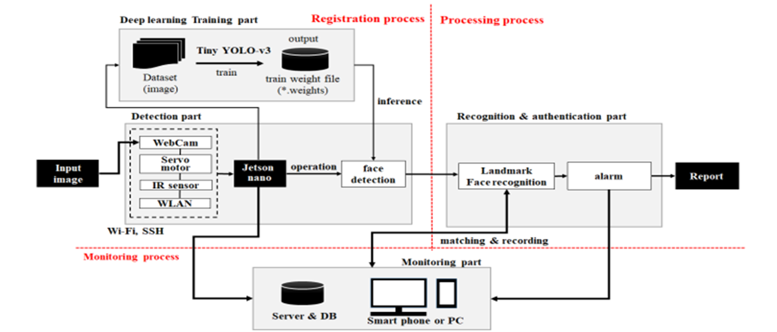
DESIGN FOR VISITOR AUTHENTICATION BASED ON FACE RECOGNITION TECHNOLOGY USING CCTV
BLOCK DIAGRAM:

Slide 11
DESIGN FOR VISITOR AUTHENTICATION BASED ON FACE RECOGNITION TECHNOLOGY USING CCTV
FACE RECOGNITION CODE:
import cv2 import face_recognition # Load the known images and encoding them known_image = face_recognition.load_image_file("known_face.jpg") known_face_encoding = face_recognition.face_encodings(known_image)[0] # Initialize some variables face_locations = [] face_encodings = [] process_this_frame = True # Start the webcam video_capture = cv2.VideoCapture(0) while True: # Grab a single frame of video ret, frame = video_capture.read() # Resize frame of video to 1/4 size for faster face recognition processing small_frame = cv2.resize(frame, (0, 0), fx=0.25, fy=0.25) # Convert the image from BGR color (which OpenCV uses) to RGB color (which face_recognition uses) rgb_small_frame = small_frame[:, :, ::-1] # Only process every other frame of video to save time if process_this_frame: # Find all the faces and face encodings in the current frame of video face_locations = face_recognition.face_locations(rgb_small_frame) face_encodings = face_recognition.face_encodings(rgb_small_frame, face_locations) for face_encoding in face_encodings: # See if the face is a match for the known face(s) matches = face_recognition.compare_faces([known_face_encoding], face_encoding) name = "Unknown" # If a match was found in known_face_encodings, just use the first one. if matches[0]: name = "Known" # Draw a box around the face top, right, bottom, left = face_locations[0] top *= 4 right *= 4 bottom *= 4 left *= 4 cv2.rectangle(frame, (left, top), (right, bottom), (0, 0, 255), 2) # Draw a label with a name below the face cv2.rectangle(frame, (left, bottom - 35), (right, bottom), (0, 0, 255), cv2.FILLED) font = cv2.FONT_HERSHEY_DUPLEX cv2.putText(frame, name, (left + 6, bottom - 6), font, 1.0, (255, 255, 255), 1) process_this_frame = not process_this_frame # Display the resulting image cv2.imshow('Video', frame) # Hit 'q' on the keyboard to quit! if cv2.waitKey(1) & 0xFF == ord('q'): break # Release handle to the webcam video_capture.release() cv2.destroyAllWindows()

Slide 12
DESIGN FOR VISITOR AUTHENTICATION BASED ON FACE RECOGNITION TECHNOLOGY USING CCTV
METHODOLOGY:
YOLOv7 (You Only Look Once, Version 7) is a real-time object detection algorithm that identifies specific objects in videos, live feeds, or images.
The YOLO machine learning algorithm uses features learned by a deep convolutional neural network to detect an object.

Slide 13
DESIGN FOR VISITOR AUTHENTICATION BASED ON FACE RECOGNITION TECHNOLOGY USING CCTV
STEPS FOR YOLO V7 ALGORITHM:
The inputs is a batch of images of shape (m, 416, 416, 3).
YOLO v7 passes this image to a convolutional neural network (CNN)
The last two dimensions of the above output are flattened to get an output volume of (19, 19, 425)
Here, each cell of a 19 x 19 grid returns 425 numbers
425 = 5 * 85, where 5 is the number of anchor boxes per grid.
85 = 5 + 80, where 5 is (pc, bx, by, bh, bw) and 80 is the number of classes we want to detect.
The output is a list of bounding boxes along with the recognized classes. Each bounding box is represented by 6 numbers (pc, bx, by, bh, bw, c). If we expand c into an 80-dimensional vector, each bounding box is represented by 85 numbers
Finally, we do the IoU (Intersection over Union) and Non-Max Suppression to avoid selecting overlapping boxes

Slide 14
DESIGN FOR VISITOR AUTHENTICATION BASED ON FACE RECOGNITION TECHNOLOGY USING CCTV
TO ENSURE ACCURATE FACE AUTHENTICATION, THE FOLLOWING CONDITIONS MUST BE MET:
Sufficient lighting: Adequate lighting is necessary to capture a clear image of the face. Poor lighting conditions, such as low light or bright backlight, can result in inaccurate facial recognition
Unobstructed face: The face should not be obstructed by any object, such as a hat, sunglasses, or mask. These objects can prevent the facial recognition system from accurately identifying the individual.
Clear image: The image of the face should be clear and not blurry. Blurry images can make it difficult for the facial recognition system to accurately identify the individual.
Proper distance: The person's face should be positioned at the proper distance from the camera. If the face is too close or too far away, the facial recognition system may not work accurately.
Consistent face: The person's face should be consistent with the reference image stored in the system. Changes in facial appearance, such as facial hair, glasses, or aging, can impact the accuracy of the facial recognition system.
No spoofing attempts: There should be no attempt to spoof the facial recognition system, such as by using a printed photograph or a mask to impersonate the authorized individual.

Slide 15
DESIGN FOR VISITOR AUTHENTICATION BASED ON FACE RECOGNITION TECHNOLOGY USING CCTV
ADVANTAGE:
a low cost since it is stand alone and not server -based.
High accuracy.
High recognition.
Safe from various attacks, provided convenience, and allowed visitor authentication.
APPLICATION:
1.Colleges
2.Offices

Slide 16
DESIGN FOR VISITOR AUTHENTICATION BASED ON FACE RECOGNITION TECHNOLOGY USING CCTV
SYSTEM REQUIREMENT:
•H/W System Configuration:-
1.Processor - Pentium –IV
2.RAM - 4 GB (min)
3.Hard Disk - 20 GB
•S/W System Configuration:-
1.Operating System : Windows 10
2.Tools: python, Jupiter notebook, anaconda tool, atom.
3.Language: python, HTML, Bootstrap, CSS

Slide 17
DESIGN FOR VISITOR AUTHENTICATION BASED ON FACE RECOGNITION TECHNOLOGY USING CCTV
WORKING PROCESS:
Tracking visitors location and status
Allows to synchronize visitors data that registered twice or more with different information
Allows to Print visitor card
Allows to generate report of visitors status and purpose of visit
Detects, identifies and captures visitor face by using (CCTV)
Updates visitor statistics
Invites and schedule appointment data over the local
area network (LAN) or through web-based system.
Creating log file for the administrator to monitor the visitors
Alert the person to be visited by using email and short message system (SMS) regarding the visitors appointment.

Slide 18
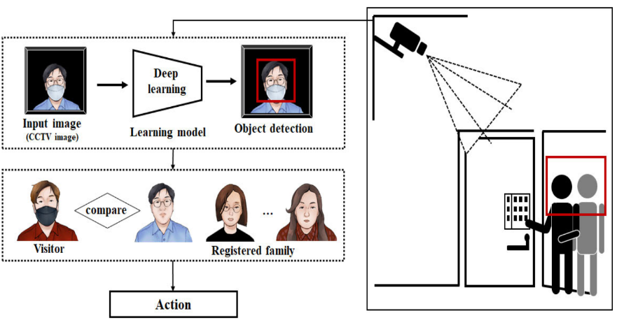
DESIGN FOR VISITOR AUTHENTICATION BASED ON FACE RECOGNITION TECHNOLOGY USING CCTV
OUTPUT MODEL TEST IMAGES:

Slide 19
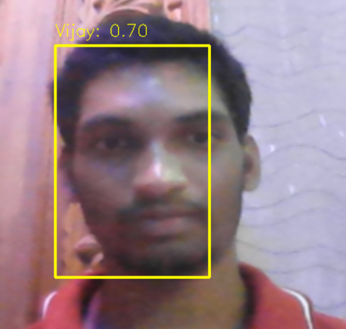

DESIGN FOR VISITOR AUTHENTICATION BASED ON FACE RECOGNITION TECHNOLOGY USING CCTV
OUTPUT:

Slide 20
DESIGN FOR VISITOR AUTHENTICATION BASED ON FACE RECOGNITION TECHNOLOGY USING CCTV
CONCLUSION:
Deep learning, a major technology of artificial intelligence, is growing rapidly as it is applied to voice recognition and image recognition. In particular, deep learning technology in the field of image recognition is being applied as a core technology to autonomous driving and crime prevention monitoring systems, which are emerging as future industries. As for deep learning models in the field of image recognition, various algorithms that have improved and developed CNNs capable of image processing have been proposed.

Slide 21
DESIGN FOR VISITOR AUTHENTICATION BASED ON FACE RECOGNITION TECHNOLOGY USING CCTV
REFERENCES:
•[1] T.-H. Tsai, C.-C. Huang, C.-H. Chang, and M. A. Hussain, ‘‘Design of wireless vision sensor network for smart home,’’ IEEE Access, vol. 8,pp. 60455–60467, 2020, doi: 10.1109/ACCESS.2020.2982438.
•[2] K. Muhammad, J. Ahmad, I. Mehmood, S. Rho, and S. W. Baik, ‘‘Convolutional neural networks based fire detection in surveillancevideos,’’ IEEE Access, vol. 6, pp. 18174–18183, 2018, doi:10.1109/ACCESS.2018.2812835.
•[3] M. T. Bhatti, M. G. Khan, M. Aslam, and M. J. Fiaz, ‘‘Weapon detectionin real-time CCTV videos using deep learning,’’ IEEE Access, vol. 9,pp. 34366–34382, 2021, doi: 10.1109/ACCESS.2021.3059170.

Slide 22
DESIGN FOR VISITOR AUTHENTICATION BASED ON FACE RECOGNITION TECHNOLOGY USING CCTV
WORK CONTRIBUTION :
NAME:MOHAMED MOHAIDEEN A ROLL NO: 191EC205
1) I have a major role in the initial planning of the project.
2) The previous work on our project were analysed and new modification were done.
3) I have analysed many research papers and it was helped in formulating the work flow of project.
4) All the referred materials were compiled and their advantages, advancement and the points of disadvantages were analysed and adopted
5) I have collected datasets 70% for training and 30% for testing.
6) I have done all the ppt works on our project and I helped to remove the plagiarism for the report.
7) I have a major role in taking contents for weekly process.
8) I have also helped in coding process and once we completed our project I have presented a paper in the conference.

Slide 23
DESIGN FOR VISITOR AUTHENTICATION BASED ON FACE RECOGNITION TECHNOLOGY USING CCTV
WORK CONTRIBUTION :
NAME:VIJAY J ROLL NO: 191EC310
1) I have take part in Coding side.
2) I had a part in analysing literature survey.
3) I am taking responsibility for conference.
4) Taking part in analysing the result.
5) Take part in training data sets.
6) Take part in preparing report.

Slide 24
DESIGN FOR VISITOR AUTHENTICATION BASED ON FACE RECOGNITION TECHNOLOGY USING CCTV
WORK CONTRIBUTION :
NAME:VIKRAM ROLL NO: 191EC311
1) I have take part in training data sets.
2) Take part in analysing literature survey.
3) I have a major part in PPT works.
4) Have a role in initial planning of the project.
5) I have a major part in Report preparation.
6) I have take part in coding side.

Slide 25
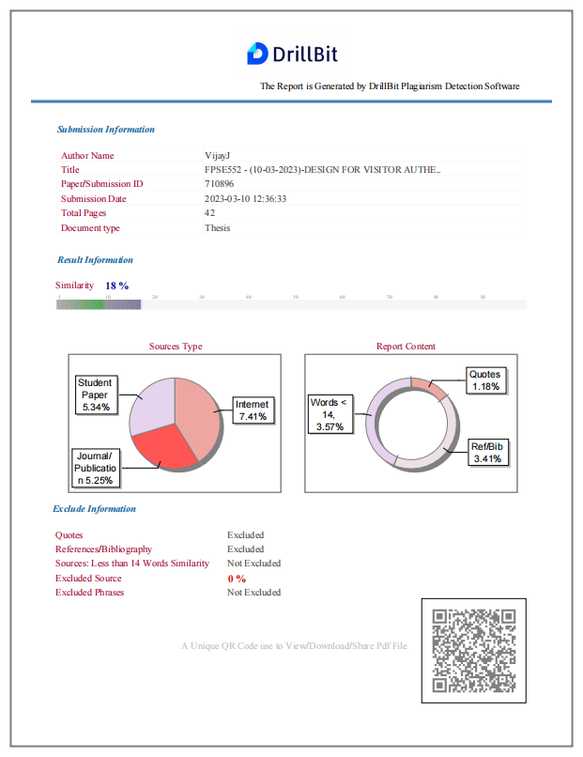

DESIGN FOR VISITOR AUTHENTICATION BASED ON FACE RECOGNITION TECHNOLOGY USING CCTV

Slide 26

DESIGN FOR VISITOR AUTHENTICATION BASED ON FACE RECOGNITION TECHNOLOGY USING CCTV

Slide 27

DESIGN FOR VISITOR AUTHENTICATION BASED ON FACE RECOGNITION TECHNOLOGY USING CCTV

Slide 28

DESIGN FOR VISITOR AUTHENTICATION BASED ON FACE RECOGNITION TECHNOLOGY USING CCTV

